Slide 1
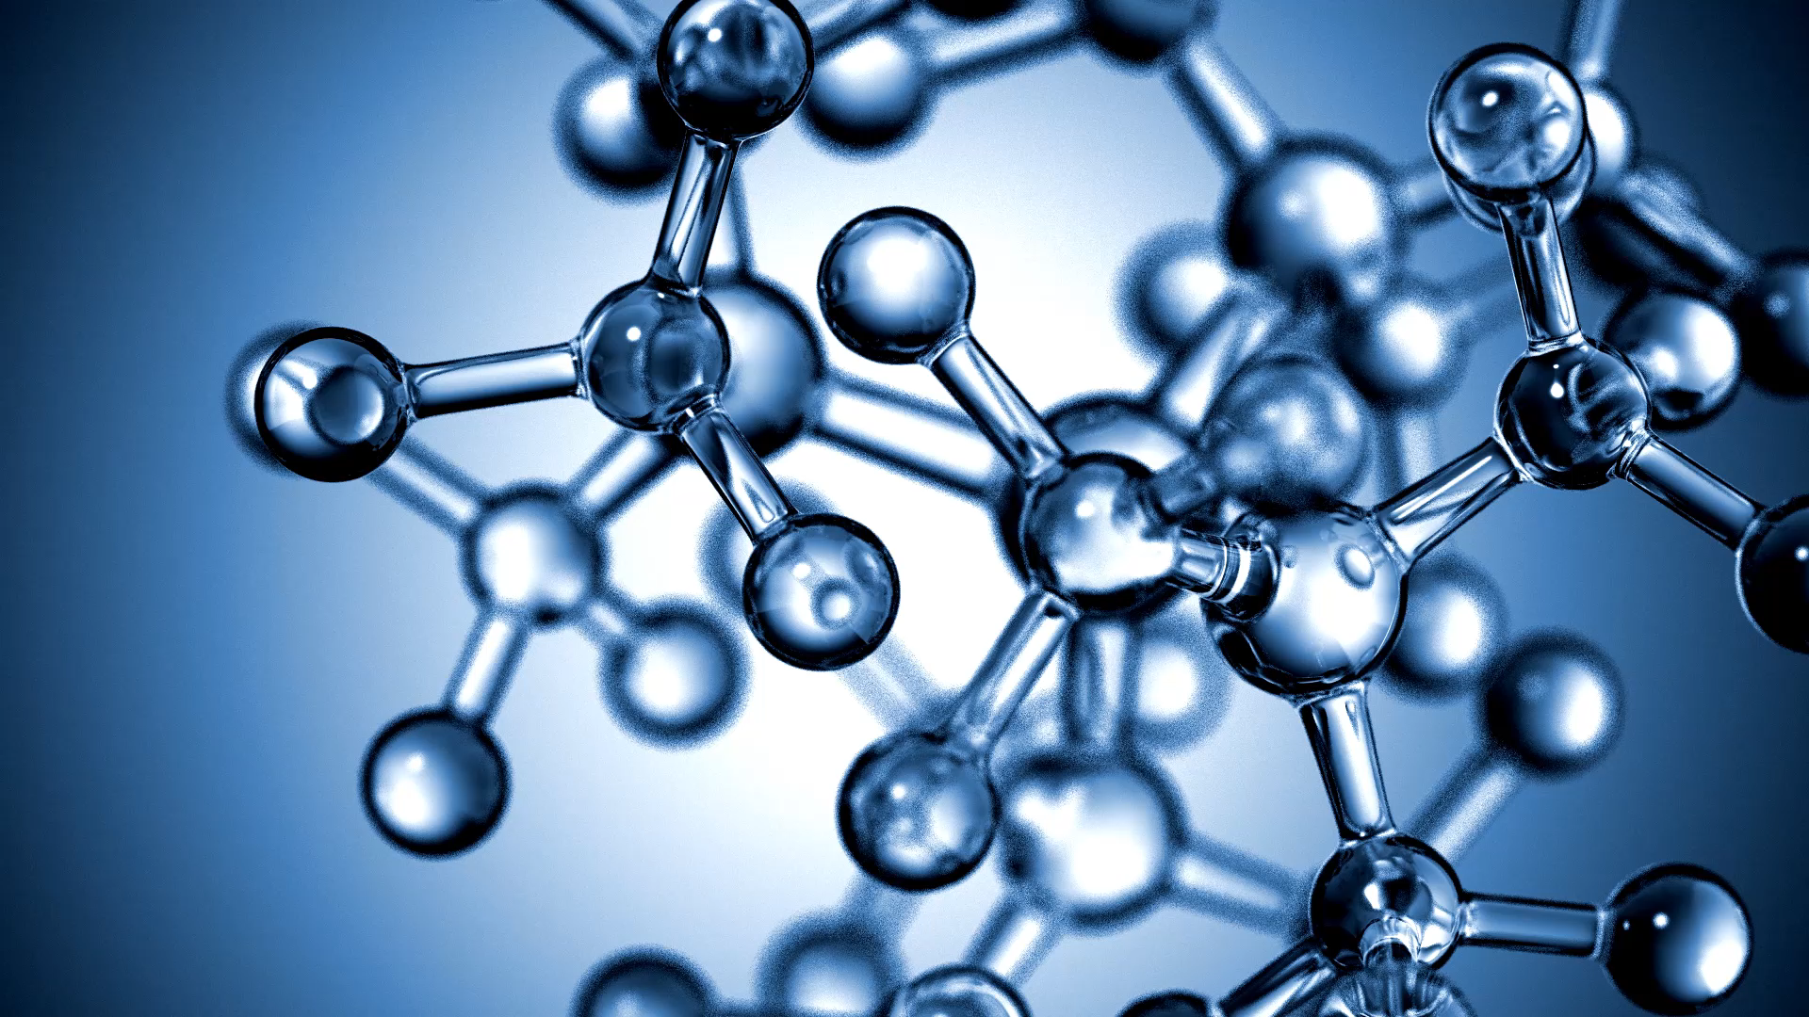
LAB#05
Artificial Intelligence
Abdul Haseeb

Slide 2
Lab Objectives
Matplotlib and Seaborn for Data Visualization
Pandas: Groupby, Adding and Removing Rows and Columns, Renaming the existing columns, loc and iloc

Slide 3
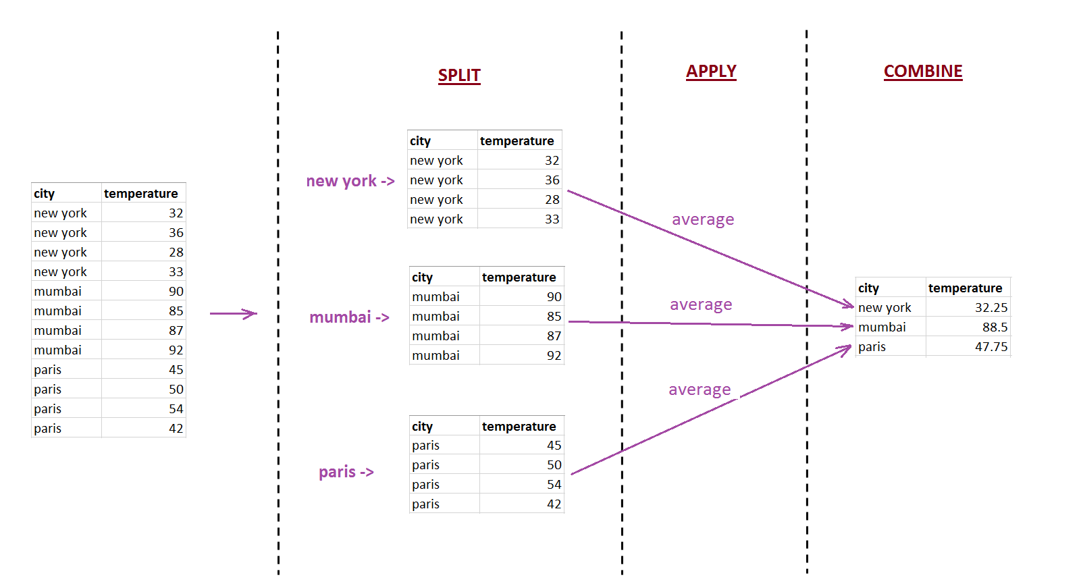
GroupBy

Slide 4
loc vs iloc
loc:
Used for labeled Indexing, where index is a text label
Can use Numeric Indexing, but the last index will be included
Can accept Boolean data
iloc:
Used for numeric indexing, where index is integer
Last index will not be included
Can not accept Boolean data

Slide 5
Tasks
Section 3: Data Grouping
Group wines by quality rating and calculate the mean alcohol content.
Group wines by pH level (acidic, neutral, basic) and calculate the mean quality rating.
Section 4: Data Sorting
Sort wines by quality rating in descending order.
Sort wines by alcohol content in ascending order.

Slide 6
Tasks
Section 5: Data Concatenation
Concatenate the red wine dataset with the white wine dataset

Slide 7

Why Data Visualization
A picture is worth a thousand words!

Slide 8
What is Data Visualization
Data Visualization is the process to visualize the data in picture form
Data Visualization allows us to communicate the insights from the data easily with the stakeholders

Slide 9
Matplotlib
Library/Module for Data Visualization
Submodule pyplot is used for creating various plots
Inside a plot we have figure and axes

Slide 10
Figure and Axis
Figure object is container which holds everything which we see on the page
Axis is the part of the page that holds the data, it is the canvas on which we will draw our data to visualize it

Slide 11
Types of Plots to Cover
Line Plot
Bar Plot
Scatter Plot
Pie Plot

Slide 12
Some other Libraries
Ggplot2
Seaborn
etc

